Slide 1
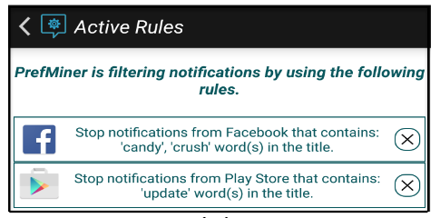
PrefMiner: Mining User’s Preferences for Intelligent Mobile Notification Management
Motivation:
Interruptibility management system should
send notifications only in OM
stop non-useful, uninteresting or irrelevant notifications
Goal:
An app that learns the types of information users prefer to receive via notifications in different situations
[1] Mehrotra, Abhinav, et al. "My phone and me: understanding people's receptivity to mobile notifications." Proceedings of the 2016 CHI conference on human factors in computing systems. 2016.

Slide 2
PrefMiner: Mining User’s Preferences for Intelligent Mobile Notification Management
Motivation:
Interruptibility management system should
send notifications only in OM
stop non-useful, uninteresting or irrelevant notifications
Goal:
An app that learns the types of information users prefer to receive via notifications in different situations
Summary:
Offline evaluation on MyPhone & Me dataset
18 users // 11,185 notifications // with at least 14 days of data for each user
In-the-wild 15-day experiment
16 subjects are suggested 179 rules
56.98% of suggested rules are accepted
45% of unwanted notifications are filtered out
[1] Mehrotra, Abhinav, et al. "My phone and me: understanding people's receptivity to mobile notifications." Proceedings of the 2016 CHI conference on human factors in computing systems. 2016.

Slide 3
PrefMiner: Design Choices
Learning users’ preferences instead of modeling their interruptibility by
learning the different types of unwanted interruptions that users explicitly refuse by dismissing notifications
Then, dismiss unwanted types of interruption
Association rules over ML models because:
Users should be involved while removing unwanted interruptions without compromising the reception of any important information
Interpretability of rules
ML models from previous studies are not interpretable [21,28,24]
Mined association rules can be easily understood by users
Users can provide their feedback about the mined association rules
Notes:
Preferences with respect to different types of information delivered through notifications

Slide 4
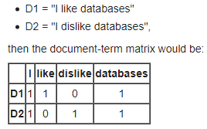
Mining User Preferences:
Notification title classification
Standard NLP preprocessing of notification title
Constructing a clusters for each app’s notifications
Compute Document-Term Matrix (DTM)
Clustering each application’s notifications separately with DTM and DBSCAN (e.g., N₁, N₂ )
Constructing Association Rules using
Context
Type of notification
Location
Time of the day
User’s physical activity (e.g., Walking, still)
Consequent
Whether Accept or Dismiss notification

Slide 5
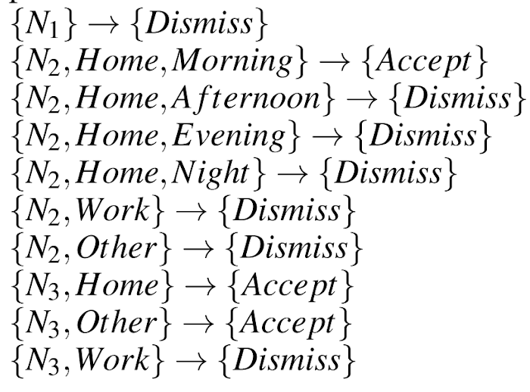
Mining User Preferences:
Notification title classification
Standard NLP preprocessing of notification title
Constructing a clusters for each app’s notifications
Compute Document-Term Matrix (DTM)
Clustering each application’s notifications separately with DTM and DBSCAN (e.g., N₁, N₂ )
Constructing Association Rules
ARM is constructed using
Context
Type of notification
Location
Time of the day
User’s physical activity (e.g., Walking, still)
Consequent
Whether Accept or Dismiss notification
Example:
Observed User Behavior:
always dismiss Twitter suggestion (N1) notifications for who to follow;
accepts Facebook birthday reminder notifications (N2) only in the morning while she is at home;
does not accept WhatsApp notifications from Alice (N3) while at work.
Association Rules from User Behavior:

Slide 6
Evaluation of Rule-based Mechanism: Setting
Dataset: My Phone and Me [25]
18 users
11,185 notifications
Eval procedure
For each user 10-fold CV ~ 9:1 train:test split
So for each fold
ARs are mined from 90% of user data
Tested on 10% of user data
Aggregated users’ scores by
Mean
(margin of) Standard error with 95% CI
Eval Metrics:
Recall
Precision
Outcome variable
notification response: the user’s response (i.e., click or dismiss) to a notification;
Context Features:
notification type: the identifier of the cluster to which the notification belongs;
arrival time: the arrival time of the notification considering four time slots – morning (6-12), afternoon (12-16), evening (16-20) and night (20-24 and 0-6);
activity: the user’s physical activity (includes still, walking, running, biking and in vehicle) when the notification arrived;
location: the user’s location when the notification arrived;

Slide 7
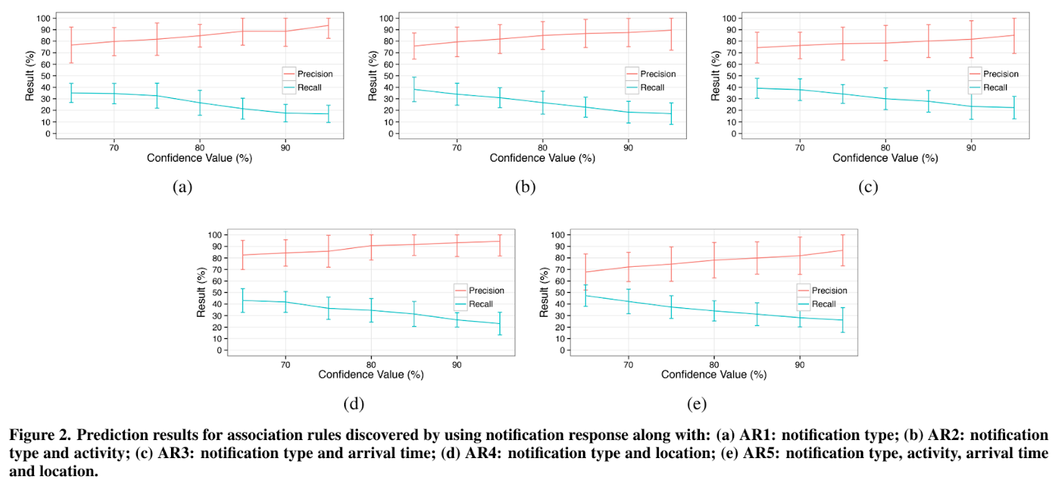
Evaluation of Rule-based Mechanism: Results
Key Insight:
user’s preference for receiving notifications does not depend on the activity and arrival time
User preference for notification depends on the type of information it contains and the location of the user
at a confidence of 80%, 35 recall and 90% precision is achieved
Notes:
results provide evidence that the
but.

Slide 8
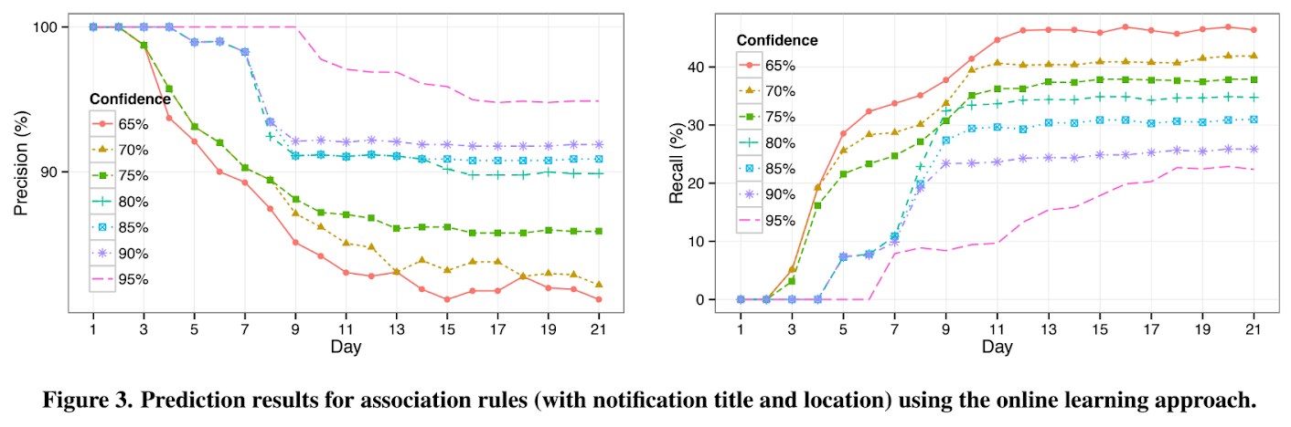
Evaluation Results: Online Learning
Setting:
It is not mentioned how many users and notifications
New rules are constructed at the end of each day using notifications from Day 1 till Day N-1, evaluated on Notifications of Day N
Confidence of the rules are color coded
Observation:
Rules with Cmin as 80 and below start filtering notifications from the 3rd day and by the 7th day they achieve the recall of 25-35% and precision around 90%.
other rules could achieve the recall of 10% and precision above 90% by 7-th day.
Notes:
results provide evidence that the
but.

Slide 9
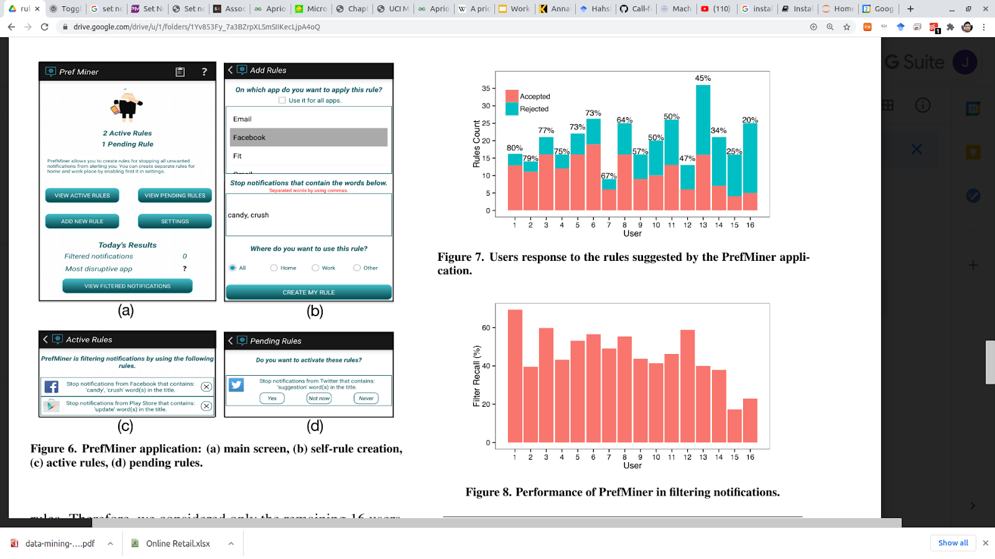
Evaluation results: In the wild Evaluation
16 users // 15 days
During the study PrefMiner suggested 179 rules to the participants out of which 102 rules (i.e., ~57%) were accepted (Fig. 7).

Slide 10
Evaluation results: In the wild Evaluation
16 users // 15 days
During the study PrefMiner suggested 179 rules to the participants out of which 102 rules (i.e., ~57%) were accepted (Fig. 7).
Pref Miner identifies around 60% of unwanted (dismissed by the user) notifications (Fig. 8).

